Slide 1
Beijing Air Quality
Data Analytics Study (2013 – 2017)
PRSA Multi-Station Dataset • 12 Stations • 420,768 Records
Task 1: Load & Inspect
Task 2: Data Cleaning
Task 3: Statistics
Task 4: Filtering
Task 5: Visualisation
Task 6: Correlation

Slide 2
Task 1 · Load & Inspect the Dataset
12
420,768
18
4 Years
CSV Files Loaded
Total Records
Columns
Date Range
one per station
hourly readings
features
Mar 2013 – Feb 2017
Key Columns in the Dataset
No, year, month, day, hour
Timestamp components
PM2.5, PM10
Fine & coarse particulate matter (µg/m³)
SO2, NO2, CO, O3
Gas pollutants
TEMP, PRES, DEWP, RAIN, WSPM, wd
Weather variables
station
One of 12 Beijing monitoring stations

Slide 3
Dataset Column Descriptions
📅 IDENTIFIERS
🌧 WEATHER
No: Row index number within each station file
year, month, day, hour: Timestamp broken into 4 separate integer columns
Station: Name of the monitoring station (one of 12 locations across Beijing)
TEMP: Air temperature in degrees Celsius. Negative in winter. Key driver of pollution — cold air traps pollutants near the surface.
PRES: Atmospheric pressure in hPa. Higher in winter (cold air is denser). Strongly negative correlation with TEMP (r = −0.81).
DEWP: Dew point temperature in °C. The temperature at which air becomes saturated with moisture. Highly correlated with TEMP (r = 0.82).
RAIN: Hourly precipitation in mm. Rain washes particulates out of the air. Most hours record 0 mm; extreme events are rare.
WSPM: Wind speed in m/s. Higher wind disperses pollutants. Negatively correlated with PM2.5 (r = −0.27) as expected.
WD: Wind direction as a compass point (e.g. N, NE, SW). Categorical column; filled using forward/backward fill during cleaning.
🌫 POLLUTANTS
PM2.5: Fine particulate matter ≤2.5 micrometres. Most harmful to human health; penetrates deep into lungs and bloodstream. Unit: µg/m³
PM10: Coarser particulate matter ≤10 micrometres. Includes PM2.5 plus larger dust and pollen particles. Unit: µg/m³
SO2: Sulphur dioxide. Released by coal burning and industrial processes. Causes respiratory irritation and acid rain. Unit: µg/m³
NO2: Nitrogen dioxide. Emitted by vehicles and power plants. Contributes to smog formation and lung damage. Unit: µg/m³
CO: Carbon monoxide. Product of incomplete combustion (vehicles, heating). Values in thousands because CO is emitted in large mass quantities. Unit: µg/m³
O3: Ground-level ozone. Forms via sunlight reacting with NO2. Higher in summer; negatively correlated with PM2.5. Unit: µg/m³

Slide 4
Task 2 · Data Cleaning
1
Identified Nulls
isnull().sum() revealed CO had 20,701 missing values (~4.9%), NO2 had 12,116
2
Linear Interpolation
Sorted by station + datetime, then interpolated within each station's own time series — estimates each gap from surrounding hourly readings
3
Wind Direction (ffill/bfill)
Categorical 'wd' can't be interpolated — forward-filled then backward-filled per station
4
Dropped Edge Cases
dropna(subset=['PM2.5']) catches rare edge gaps at series start/end with no neighbours — 0 rows lost
Why Interpolation? This is hourly time series data — pollution changes gradually. Interpolation respects the temporal pattern; median would inject the same global value regardless of time.

Slide 5
Task 3 · Basic Statistical Analysis
Pollutant
Mean
Median
Min
Max
Std Dev
PM2.5
79.8
55.0
2.0
999.0
80.8
PM10
104.6
82.0
2.0
999.0
91.8
SO2
19.1
10.0
2.0
494.8
27.3
NO2
54.2
47.0
2.0
294.0
35.5
CO
1230.8
900.0
100.0
10000.0
1160.2
O3
57.4
45.0
0.2
1071.0
56.7
79.8 µg/m³
999 µg/m³
1,160
PM2.5 Mean
Max PM2.5
CO Std Dev
≈ 8× WHO guideline of 10
Extreme pollution events
High variability — traffic

Slide 6
Task 4 · Data Filtering
Key Findings
Dongsi
86.2 µg/m³
Most polluted — urban core
Wanshouxigong
85.0 µg/m³
2nd highest — central Beijing
Dingling
66.0 µg/m³
Cleanest — suburban / forest
Huairou
69.6 µg/m³
2nd cleanest — rural north

Slide 7
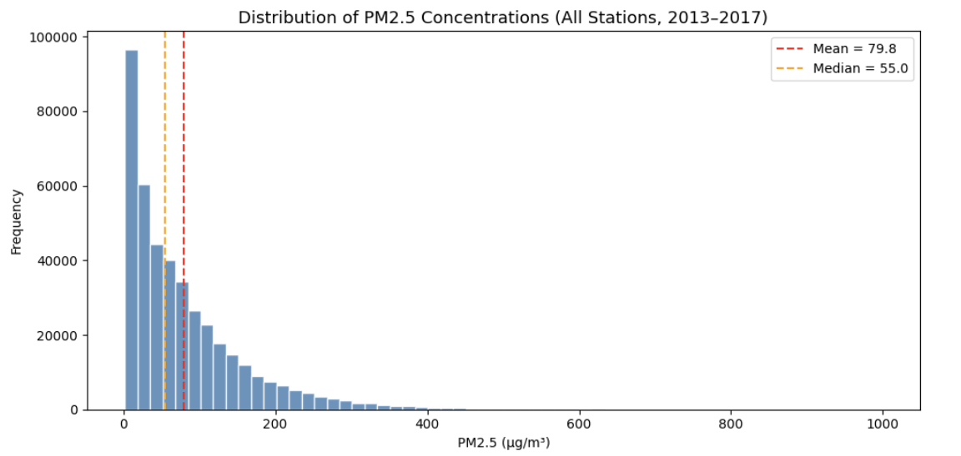
Task 5 · Data Visualization - PM2.5 Distribution Histogram
What this chart shows:
The histogram reveals a right-skewed distribution — most hourly readings fall between 0–150 µg/m³ but a long tail extends toward extreme values near 999 µg/m³. The red dashed line marks the mean (79.8) and the orange dashed line marks the median (55.0). The gap between them confirms the skew: severe pollution events pull the mean above the typical value, making the median a more representative measure of an average hour.

Slide 8
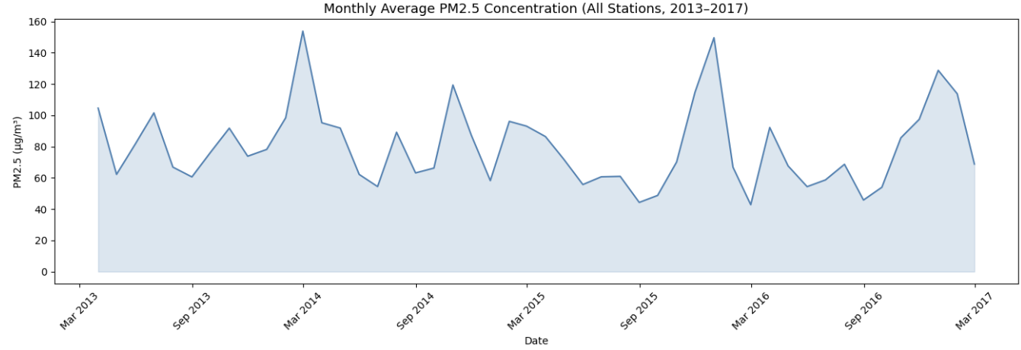
Task 5 · Data Visualization - PM2.5 Over Time Line Plot
What this chart shows:
The line plot shows monthly-averaged PM2.5 across all 12 stations from March 2013 to February 2017. A clear seasonal pattern repeats every year — sharp spikes each winter (November–February) driven by coal and gas heating emissions, followed by cleaner summer months when warmer air promotes better atmospheric mixing. The shaded area highlights the magnitude of these swings. The pattern is consistent across all four years, confirming heating season as the primary pollution driver.

Slide 9
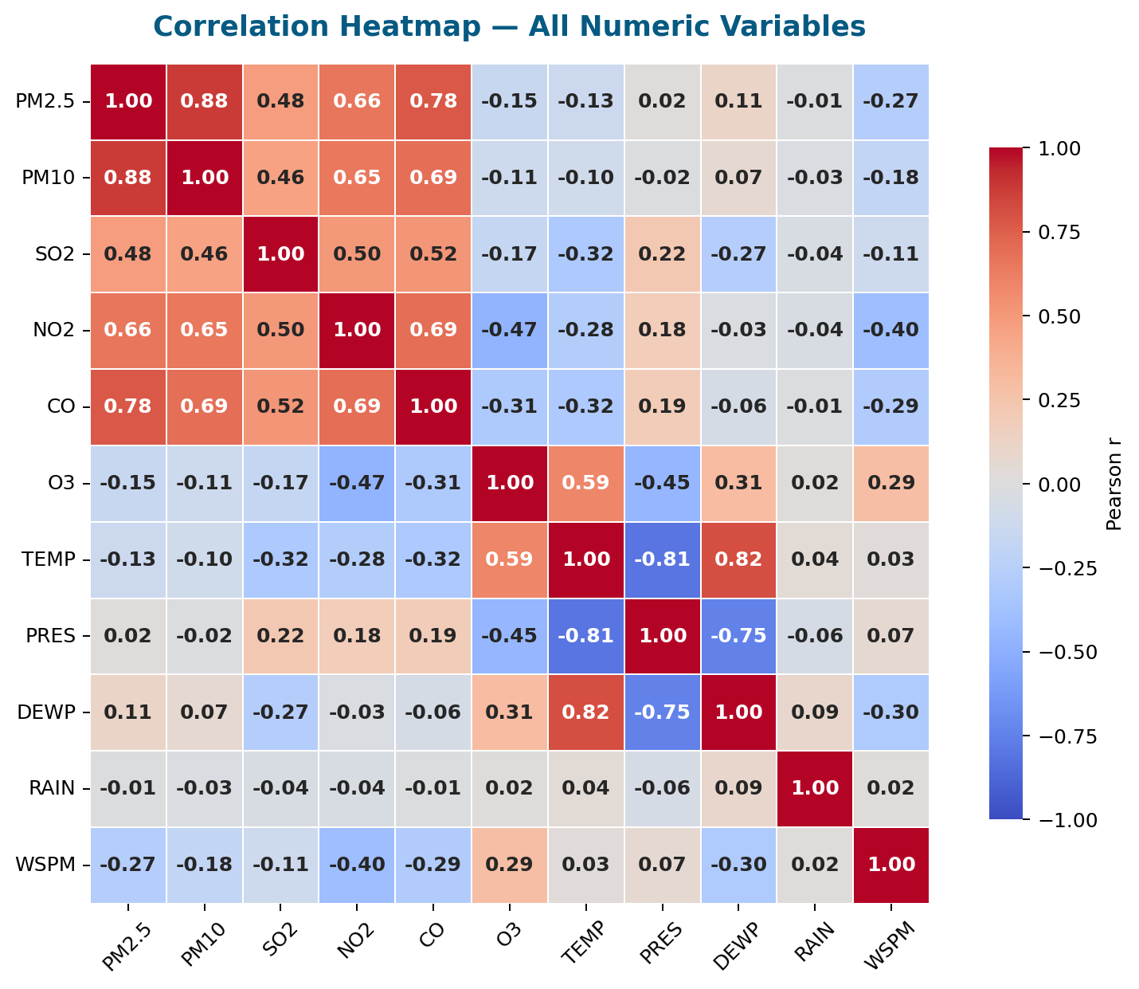
Task 6 · Correlation Heatmap
Key Observations
0.88
PM2.5 ↔ PM10
Strongest link — both track particulate matter
0.78
PM2.5 ↔ CO
Combustion sources drive both simultaneously
0.82
TEMP ↔ DEWP
Weather variables tightly coupled
−0.81
TEMP ↔ PRES
Cold air = higher pressure — classic pattern
−0.27
PM2.5 ↔ WSPM
Wind disperses pollution — negative as expected

Slide 10
Task 6 · Correlation Analysis
Q1: Most correlated variable?
PM10
r = 0.884 — strongest positive correlation
Both measure particulate matter — PM10 includes coarser particles that contain PM2.5, so they naturally rise and fall together.
Q2: Does temperature affect pollution?
Yes — r = −0.131 (negative)
Cold weather = higher PM2.5. Likely driven by: (1) heating combustion in winter, (2) reduced atmospheric mixing in cold, stable air, trapping pollutants near the surface.

Slide 11
Summary
Beijing Air Quality Data Analytics — Key Takeaways
Dataset
Cleaning
1
2
12 stations, 420K+ hourly records spanning 4 years — combined with glob + pd.concat
Linear interpolation per station for numerics; ffill/bfill for wind direction; no rows dropped
Statistics
Filtering
3
4
PM2.5 mean of 79.8 µg/m³ is ~8× the WHO guideline — severe chronic exposure
Dongsi is most polluted; Dingling cleanest — clear urban vs. suburban gradient
Visualisation
Correlation
5
6
Winter spikes visible in the line plot; right-skewed histogram; CO dominates boxplot
PM10 (r=0.884) most correlated; temperature negative — cold air traps pollution

